Slide 1

My favourite countries
Is Amerika
Capital city- New york
Prezident- Joe biden
more than 1 million people live there.on america there is a statue of liberty

Slide 2
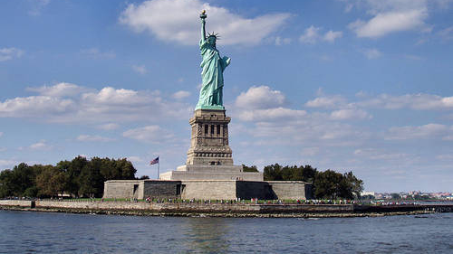
statue of Liberty(socha slobody)
in America since 1886.
was made in French.

Slide 3
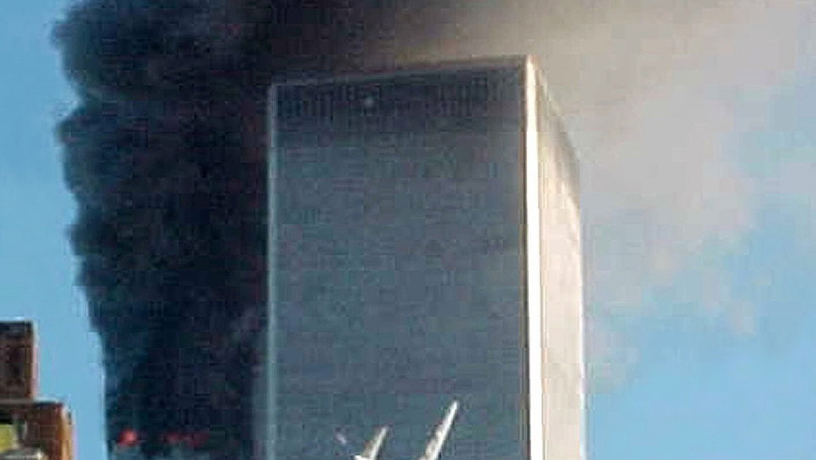
America is known mainly for music, skyscrapers, bridges and other landmarks of New York and other cities

Slide 4
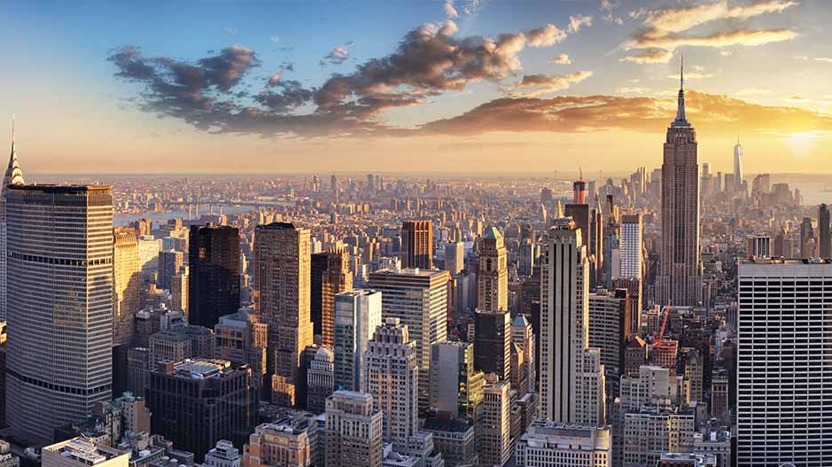
I like America, because I have a family there because there are interesting monuments and because there are exhibited rare arts that I carry on Slovakia.

